Slide 1
Booting from hard disk…
Starting Windos 98…
Start now
Click

Slide 2


Slide 5

explorer

Slide 6
Internet explorer 22.5:

Slide 8
OK
cancel

Slide 9
Hello!
Are you new to Windos?
If so, click here to start the welcome to Windos tour. If not, close the window.

Slide 10

Welcome to Windos 98!
Welcome to setup
Close the window to start the setup wizard!

Slide 11





Welcome!
Welcome to Windos 98!
This OS features:
New, tighter security
New Internet Explorer 22.5 to provide the best browsing experience
New email client to help you manage emails better
New software to get things done!
A rock- solid filesystem makes Windos a lot less prone to crashing
Alerts tell you when your security is not optimal
Many pre installed programs that are your to keep
Sleek icons
Great internet connectivity
Easy Internet Setup®
A beautiful interface which is optimised for readability
Close window to proceed

Slide 12
This OS is under construction.
Please only use it for testing purposes.
Please click me to continue

Slide 13
Installing Windos 98…

Slide 14
Complete!
Setup has finished installing Windos 98.
Please close the window to proceed with setting up Windos.

Slide 15
Welcome!
Please set a password to use with this computer:
>

Slide 16
Security alert
Setting a blank password is dangerous and this allows anyone to access the system without your contest!
Close to proceed
Go back and set a password

Slide 17
Connecting to the Internet…

Slide 18
update
Setup is ready to install updates to Windos 98.
Please close the Window to proceed.
This cannot be skipped!

Slide 19


Slide 20
updater
Updates have been installed and Windos 98 has been installed.
Please close the window and log on.

Slide 21
You need a password!
Please add one by reinstalling Windos 98!
login
Please press the button to sign in:
Sign in

Slide 22





What’s new:
Launch version.
Fixed start menu button…kind of.
Windos 98
Released 20/07/2020

Slide 23

Hint of the version:
Check out all the new changes stated in the what’s new widget!
Shortcuts:
Computer
All Apps
Power Menu
IE225
shell32.dll
Control panel
Want free robux?
Click here to learn how!

Slide 24

Username; standard user; click for old start menu
Shortcuts:
Run
Find
Explorer
All apps
IE225
Control panel
Icon file
This is a feature space.
I will add something later, please be patient.
Hint:
read the help utility for basic help!
Power off…

Slide 25
Internet Explorer 23; connected; DNS server 1.1.1.1; connection speed is 10mbps;
protocol is HTTPS; internet is secured by TSL encryption; cookies enabled; site uses 10 cookies; the browser is not the actual Internet Explorer.
Welcome to the Internet!
Please select one of these sites:
News
Version plan from developer
Goggle
Wing
Asterisk
Secrets
Gacha club
Advert
Super secret
Antivirus
CLICK ME
Free robux

Slide 26


computer
Local Disk[C]
me

Slide 27


All apps
Email 2.02
Runtime Broker
Do not open
IE22.5
Action centre
Home network manager
computer
MEMZ
Control panel
Help

Slide 28
Email client
V2. 02
For Windos 98
© 2020 M1cr0$0ft c0rp.

Slide 29
Email client v2.01 - inbox
From: windos98@ command.com
Subject: welcome to email

Slide 30
Power off
Power off
Reboot
Sign out
Sleep
Crash system

Slide 31
Crash system
Click outside of window to cancel.
Close window to accept

Slide 32


Slide 33
Windos has been uninstalled and you may shut down
Press ESC to turn off
reboot

Slide 35
Internet explorer 22.5:get aCCe55
Hey!
Click on da link 2 aCCe55 drive C if it is hidden in your version!
BTW the drive may not be 1nd3x3d s0 u m4y h4v3 2 w41t Unt1l 1t 1s Unh1dden 2 C da full d1sk!
Get aCCe55

Slide 36




explorer
C:\Windos\shell32.dll

Slide 37
explorer
C:
Windos
Username
admin
SYSTEM
windos.exe
Welcome.exe
Explorer. exe
bin

Slide 38
explorer
C:\windos
system32
winSxS
war
shell32.dll

Slide 39
Access denied!
The system does not let you access that!
This is to protect the system
Click outside to exit

Slide 40
Access denied!
The system does not let you access other user folders!
This is to protect their privacy!
Would you like it if someone looked at your documents?
Click outside to exit

Slide 41
Access denied!
The system does not let you access your user’s system folder!
This is to protect the system files associated with this user profile
Thank us later for the security!
Click outside to exit

Slide 42
Internet explorer 22.5:
Hello!
As you probably know Windos 98 has blocked you from accessing your documents located at C:\username
Click on the link to be redirected to the folder now!
Note: in a future update this bug may be patched
Note 2: Only Windos can add in documents, as the folder is read only.
Note 3: please do not delete this folder as the system needs it
Note 4: do not try and open the system sub folder.
Note 5: you may not be allowed to access sub folders.
Note 6: I refuse to update this site if the glitch is patched
Note 7: this site may be taken down, so I will hack beta 1 so that it has the shortcut in the C:\ folder.
Windos has patched the bug before it reached consumers!
Go to C:\Username

Slide 43
Internet explorer 22.5: news
News:
Hello there.
Added things can be found in the what’s new section of the desktop.

Slide 44
Action centre:
Here are your system settings in a nutshell:
Set a password for this PC
Firewall is ON
Home network detected
Web protection 2.0 OFF
Web protection ON

Slide 45
Password protection
Hey.
You need to set a password to your system!
Please reinstall the system and set one.
How to reinstall Windos

Slide 46
Home network
Your PC is visible to devices on the network as Windos detected it as a home network.
It is a work network
It I a public network

Slide 47
Web protection 2.0
Web protection 1.0 alerted you when you opened a dangerous site. It does not block it. Web protection 2.0 does. It is disabled by default to reduce lag. If you want it press here

Slide 48
Web protection
Web protection has been enabled. You will be protected from:
Scam websites
Malware sites
Other nasties
Please keep it on to surf safely.

Slide 49
Internet explorer 22.5: version plan from dev
Beta 1:
An app update
Beta 2:
Control Panel update
Beta 3:
Background stuff update
Beta 4:
Help update
Beta 5:
Final touches
V1. 00:
Launch update, will add more apps.

Slide 50
explorer
\username
documents
system
Elvis Playlist
IE225 files
Email people

Slide 51
explorer
\\\documents
Test.txt

Slide 52
explorer
\\\elvis
,Paradise Hawaiian Style
See, See rider
Burning love
Something
You gave me a mountain
Steamroller blues
My way
Love me
Johnny B Goode
Blue Suede Shoes
I’m so lonesome I could cry
I can’t stop loving you
Hound dog
What now my love
Fever
Welcome to my world
Suspicious minds
I’ll remember you
long tall sally
An American trilogy
2
2
A big hunk of love
can’t help falling in love

Slide 53
explorer
\\\ie225
Open me.mp3.exe

Slide 54
explorer
\\\people
empty

Slide 55
Change to work network?
This requires admin rights!
Yes no

Slide 56
UAC
A program requested admin access.
Enter the admin password:
OK
Cancel

Slide 57
error
The admin password was incorrect

Slide 58
Disconnect from the Internet?
This requires admin rights!
Yes no

Slide 59
Home network manager
Your device is connected to a home network.
Connection type: ethernet
Computer is connected via ethernet
Gateway is enabled
Home network enabled
Internet

Slide 60
MEMZ
Whoops!
You messed up!

Slide 61
Control panel
users
Internet
IE 22.5
programs
explorer

Slide 62
username; current user; standard user; default
Administrator; admin; system
SYSTEM, power user; system
Only admins can manage user accounts!
OK
cancel

Slide 63
IE 22.5
Internet Explorer 23
Web protection 1.0 is OFF
Web protection 2.0 is OFF
Firewall is ON
Pop up blocker ON without pop ups
Up to date browser.
22.5.0.1.12.16
Please reinstall IE22.5 in order to change the settings!
OK
cancel

Slide 64
Programs and features
Installed app list:
No apps installed by users
Show all apps
Manage system apps
Install an app
OK
cancel

Slide 65
Internet settings
Ha
Only da admin can see zis
Ha
Ha
Ha
U doomed
Pls h3lp m3 d3str0y m1cr0$0ft 4nd 3nd IE22.5
OK
cancel

Slide 66
tutorial
click
>

Slide 67
tutorial
>

Slide 68
tutorial
Welcome to Windos 98, a parody of Windows!
This OS is just for the fun of it, so do as you wish!
It was made by one person using PowerPoint.
Ok, enough rambling. Let’s learn about how to use it.
click
>

Slide 69
tutorial
The title bar tells you where in the system you are. read it. It might be handy to know if you were redirected.
click
>

Slide 70
tutorial
Buttons are there to help you move around.
All you need is a mouse and you need to look out for what your mouse looks like when you hover over the next button. This varies by OS, but you should recognise it.
click
>

Slide 71
tutorial
This is the taskbar. This lets you open the start menu and interact with the icons on the right.
>

Slide 72
tutorial
Here are the icons I was talking about.
Click on one to access the corresponding element. This is as of beta 3 by the way, so there may be more icons than this.
>

Slide 73
tutorial
This takes you to All Apps. From there you can see all the apps installed on the OS. There are not many as of beta 3 but there will be more!
>

Slide 74
tutorial
This icon does nothing as of beta 3, but it will open a volume mixer!
Click on it to open a volume mixer in future releases.
>

Slide 75
tutorial
This icon indicates that you are on a home network. Open it to go to the Home Network Manager.
>

Slide 76
tutorial
The action centre is a place to see what security issues you may have. It is an X because some settings are poorly configured.
>

Slide 77
tutorial
This opens the web browser, Internet Explorer 23. you can view websites added on to the OS.
>

Slide 78
tutorial
Here is who was talking to you the whole time!
>

Slide 79
tutorial
This opens the start menu. Nothing new, but it offers links to major areas of the system and shows a hint from Clippy.
>

Slide 80
tutorial
So, Windos is built like windows. But how do I log on and start?
>

Slide 81
tutorial
You need to close this terrible tour and start the setup wizard. Click on the next button to exit.
>

Slide 82
You found my Easter egg!
Elvis Presley once said:
‘Truth is like the sun. you can shut it away for a time, but it ain’t going away.’

Slide 84
Volume mixer 1.02
Master Volume is 100%
System 100%
Apps 100%
Games 100%
Music 0%
Etc 100%
Hahaha please do not quieten it

Slide 85
Help system
Using Help
What is Windos?
Getting started
The tutorial
Setup wizard
Desktop
Start menu
Explorer
IE 23
Accessing websites
Basic elements
Email
Windows
Message boxes
Pop ups
Icons
Modifying Windos
Feedback
notifications

Slide 86
Help system
Intro:
This help utility tries to answer common questions people may have while using Windos 98. navigate through the use of hyperlinks and read the help text.
Click on the ? Icon next to the close button to go back to the index.
See also:
Getting started
Desktop
Setup wizard

Slide 87
Help system
What is Windos?
Windos 98 is a parody of Windows.
It is supposed to look like Windows but with a basic UI and limited features. To get help, click on one of the see also links.

Slide 88
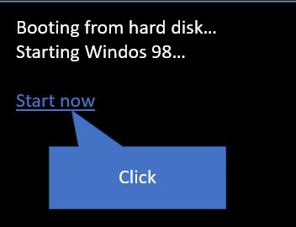
Help system
Getting started
Windos 98 is a basic OS if you learn how to use it.
It contains many elements, Easter eggs and jokes.
When you first booted up you pressed the start now button.
This redirected you to a prompt asking you if you wanted to use the tutorial. You probably pressed yes. When you hover over a clickable element, your cursor changed. Make sure to recognise it otherwise you will move onto the next slide. `
select one of the following:
The tutorial
Desktop
What is Windos?

Slide 89
Help system
The Tutorial
The tutorial tells you what the desktop looks like in an nutshell. It does not go to very deep context on what the entire OS does. To open it, you need to reboot and accept he request to open it.
See also:
Desktop
Getting started
Using help

Slide 90
Help system
Setup wizard
The setup wizard helps you install Windos. It is designed to annoy you and imitate installing Windos. Please note that it existed when Windos was 1st created. You need to follow the instructions, close windows, click on boxes, click outside of them, install updates, etc.
Follow the on-screen instructions to get onto the desktop.

Slide 91
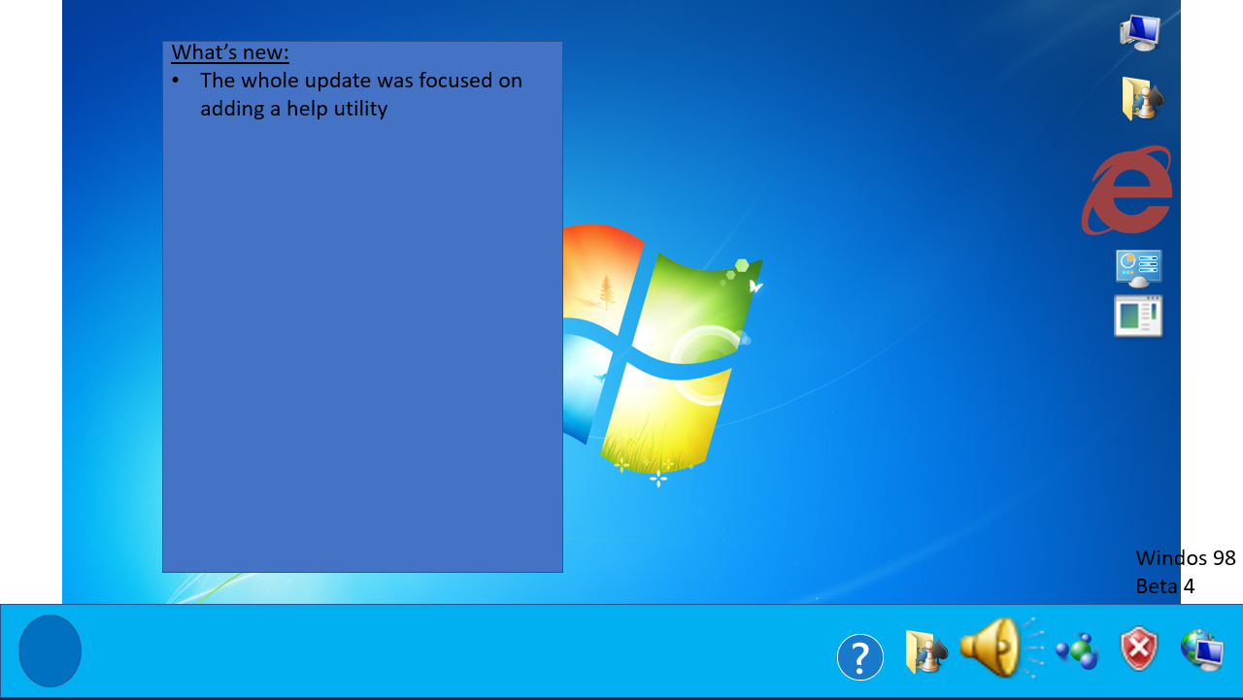
Help system
Desktop
What’s new screen shows what was updated in the version of Windos
Start button opens start menu
Desktop icons to get to places
Taskbar with icons to access some areas. Learn more in the tutorial
Build info states the Windos version

Slide 92
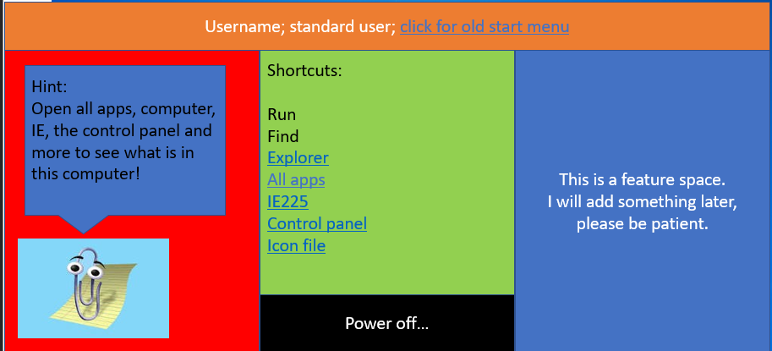
Help system
Clippy gives a hint every few versions. They can reveal Easter eggs
Start menu:
User info and access to old start menu
Shortcuts for easy access to system areas.
Power menu access.

Slide 93
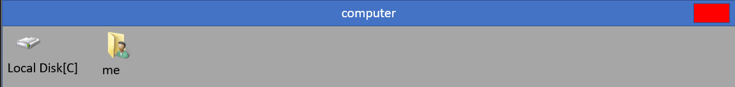
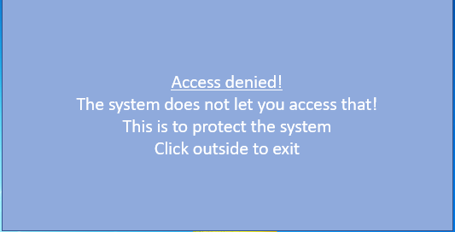
Help system
Explorer:
File explorer lets you access the C drive and your personal folder. It looks like this when opened:
The explorer icons can be pressed to view the corresponding file or folder. some areas just give you an access denied prompt and take you to the desktop. It looks like this:
Click outside of the pop up to close it.
See also:
IE 23
Email
Using Help

Slide 94
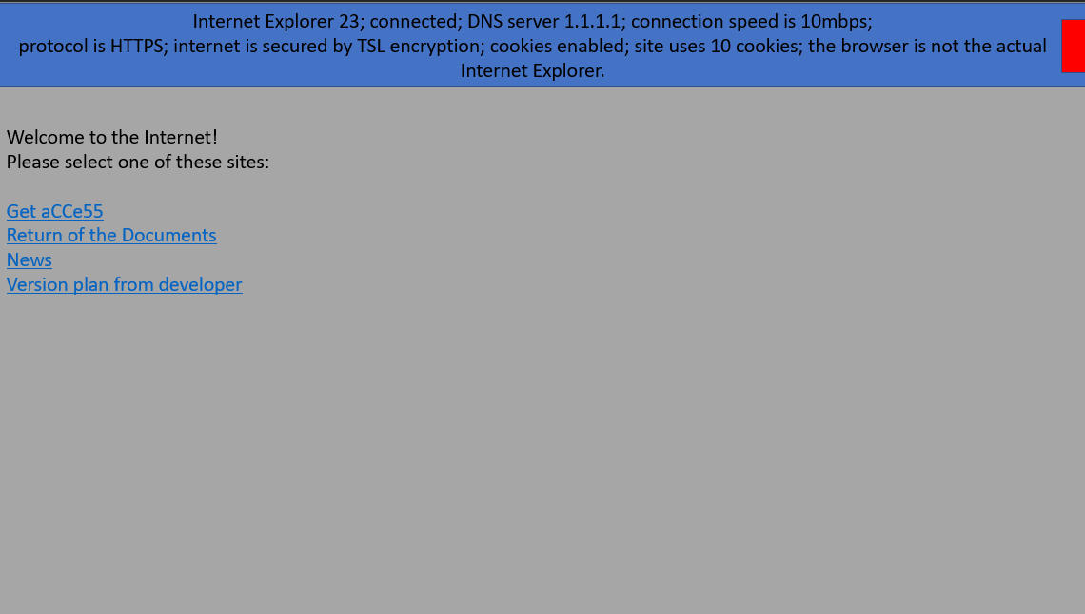
Help system
IE 23:
The web browser, Internet Explorer 23, can be opened in several ways. Click on the desktop icon, start menu entry, network icon on taskbar, etc.
The home screen looks like this:
Click on a link to access a website and press the close button to exit.

Slide 95
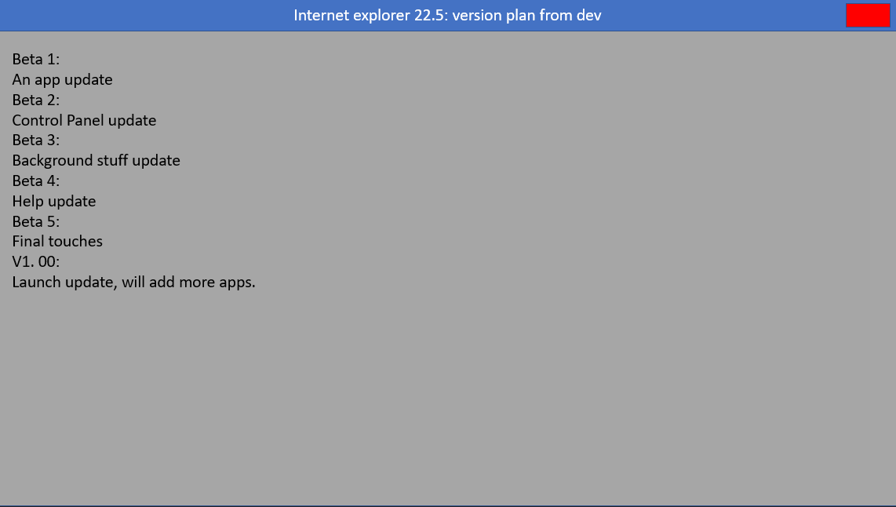
Help system
Accessing websites
When you are on a website you can browse it by clicking on links. As of beta 4 there are 4 websites added. One website looks like this:
This is a static web page. You can read It and click on links.
Close the window to go back to the IE 23 homepage.

Slide 96
Help system
Basic element:
This is a link page. It redirects you to other help pages about something related to this.
Help on message boxes
Pop ups
Windows
Message boxes
Icons
buttons

Slide 97
Help system
Email:
The email client lets you read emails. It also lets you contact the developer. Email is discontinued and has no emails as of beta 4 but this may change.

Slide 98
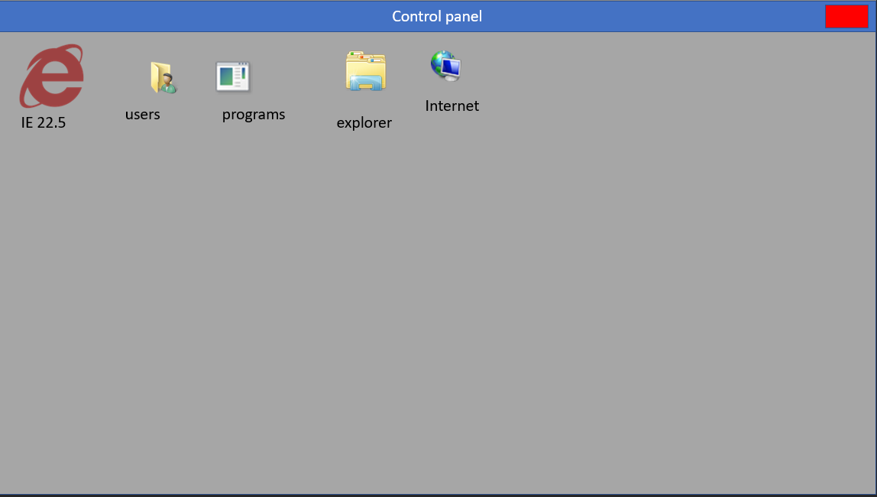
Help system
Windows
Windows look like this:
They are full screen items that can be interacted with.
Click the close button to close it.
Close button
Title bar
Window

Slide 99
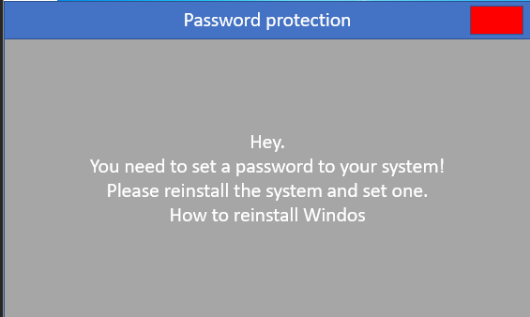
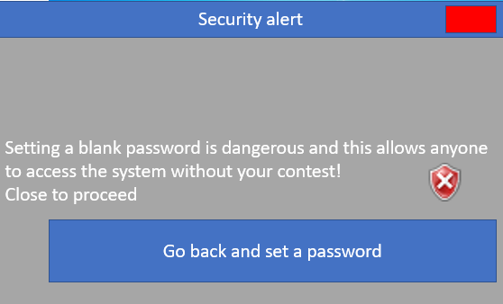
Help system
Message boxes
Message boxes look like this:
they occupy the bottom left of the screen. You often need to close the window to proceed. Some message boxes have buttons. Such boxes look like this:
You either close the box or press the button to choose an option.

Slide 100
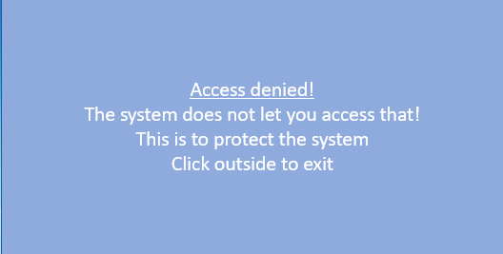
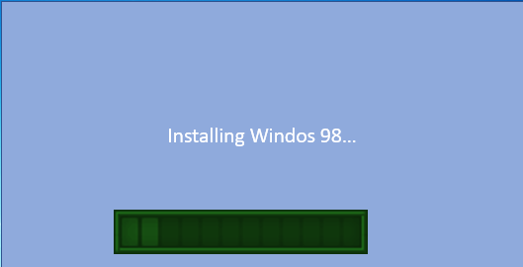
Help system
Pop ups
Pop ups look like this:
You need to read the last line to determine how to exit. Sometimes you click outside of it, sometimes it.
Some pop ups have loading bars:
Click on the bar to exit.

Slide 101
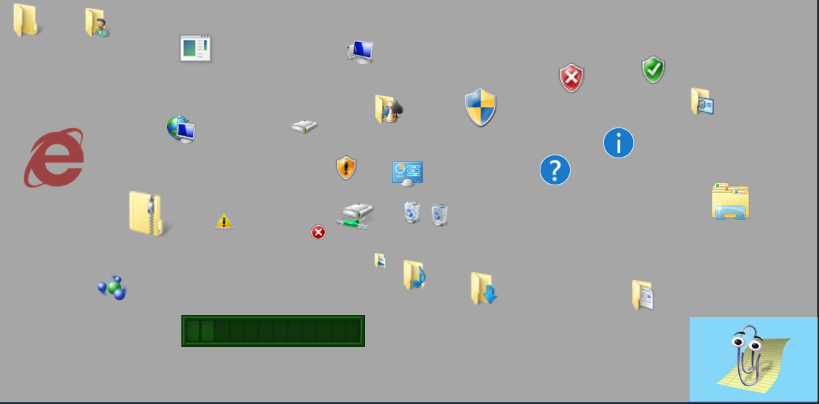
Help system
Icons
Windos 98 uses many icons taken from Windows 7, Office, and the Internet. To see all icons:
Open explorer
Go to C:\
Go to Windos
Click on shell32.dll
There are many icons, as you can see. All the icons are:

Slide 102
Help system
Modifying Windos
You are allowed to modify the code of Windos 98, as long as you:
Ensure that the developer’s name is NOT in the OS.
Name it something else
Not make money from it.
Feel free to open up PowerPoint and start making changes!
Windos 98 is open source.

Slide 103
Help system
Feedback
Click the button below to give feedback:
Be sure to state the:
Version of Windos 98
The issue or suggestion
If you want a reply or not.
>

Slide 104




Internet explorer 22.5: Goggle WARNING INSECURE
Error cannot show HTML 1.0 element

Slide 105
Internet explorer 22.5: wing no images loaded due to scam site
Search the web with Bing:
____________________________________________________ search
© 2020 Bing.com. All rights reserved.
Error cannot load
Error cannot load
Error cannot load
Error cannot load
Error cannot load
Error cannot load
Error cannot load
Error cannot load
Error cannot load
Error cannot load
Error cannot load
Error cannot load
Error cannot load
Error cannot load
Error cannot load
Error cannot load
Error cannot load
Error cannot load
Error cannot load
Error cannot load
Error cannot load
Error cannot load
Error cannot load
Error cannot load
Error cannot load
Error cannot load
Error cannot load
Error cannot load
Error cannot load
Error cannot load
Error cannot load
Error cannot load
Error cannot load
Error cannot load
Error cannot load
Error cannot load
Error cannot load
Error cannot load
Error cannot load
Error cannot load
Error cannot load
Error cannot load
Error cannot load
Error cannot load
Error cannot load
Error cannot load
Error cannot load
Error cannot load
Error cannot load
Error cannot load
Error cannot load
Error cannot load
Error cannot load
Error cannot load
Error cannot load
Error cannot load
Error cannot load
Error cannot load
Error cannot load
Error cannot load
Error cannot load
Error cannot load
Error cannot load
Error cannot load
Error cannot load
Error cannot load
Error cannot load
Error cannot load
Error cannot load
Error cannot load
Error cannot load
Error cannot load

Slide 106

Internet explorer 22.5: asterisk

Slide 107
Internet explorer 22.5: secrets
Secrets:
This guy will replace Clippy in Windos 2000!

Slide 108
Internet explorer 22.5: secrets
Secrets:
The login to a Windos 98 admin account:
Adminplusplus
Passwordplusplus
Use it well!
BTW you need to create it as a guest and a glitch will cause it to load as an admin. You then need to open regedit and go to :
HKLM\SOFTWARE\CLASSES
And delete the * key.
ONLY DO THIS ON A Windos COMPUTER AND NOT A REAL MACHINE! MODIFYING THE REGISTRY IS DANGEROUS!
This is a fake tutorial. Please ignore it. Doing what it says will harm this computer.

Slide 109
Internet explorer 22.5: ALERT YOU HAVE VIRUS
You have 4982734587396 viruses
70485612057602345 trojans
2704957293468 worms and
298347592876076 malwares on computer!
Call 911-VIRUS right now!
90 cents a minute.
We will remove them all!
And have credit card ready!
This is a scam site. Do not listen to what the site says. Clippy is fake. Close the window immediately and do not call anyone. There are no viruses on his PC anyway.

Slide 110
Internet explorer 22.5: download Avast antivirus pro for free crack
Press the below link to download Avast pro for free!
Infinity license!
Free download!
Only 100Mb!
Fast just 10 minutes!
5 minutes to install!
Hurry before the viruses get you!
This is a virus! Do not download it!
Download for free Avast pro crack premium license infinity EXE download 100Mb 15 minute install

Slide 111
Internet explorer 22.5: make money for free in a game!
Get rich quick in this addictive game!
Download and install. Play for REAL CASH!
No ads
No payment
Just loads of cash!
Get it here
‘I was worried that this was a scam. I spent ages looking for an app that worked. This one did!’- Sally
‘works like a harm. I became a millionaire by downloading the app’ –Bill
‘Love the app’ –DanTDM
‘better than Piggy’ –Thinknoodles
‘I use it all the time. Makes me do all the challenge’ –Mr Beast
This service is fake. Please note that.

Slide 112
Internet explorer 22.5: get free robux fast and easy
Want robux?
Just put in your username and password:
Username:___________________________________
Password:____________________________________
Enter amount of robux max 10000: ________
Submit here
This is a scam website. You will get hacked. Please do not proceed and close this window. The website was designed to trick you into giving away your username and password to hackers. DO NPOT PRESS!

Slide 113
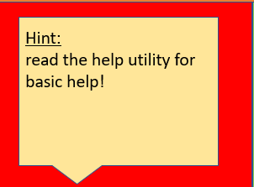

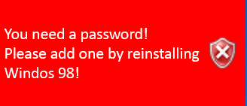

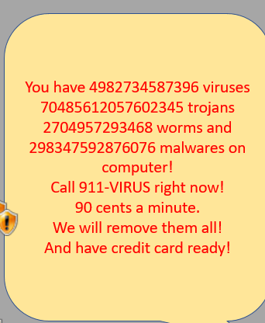
Help system
Notifications
Notifications are meant to alert you to something. Here is an example one:
Note the edges. If they are rounded they are fake. The system disallows third party apps from showing square bubbles.
Bubbles are colour coded:
Blue is system
Yellow is Clippy
Green is an advert
Red is urgent. System only.
Please remember this when viewing these notifications. Here is a fake Clippy notification:

